Slide 1
State of the AnVIL 2024
1st Annual Community Poll

Slide 2
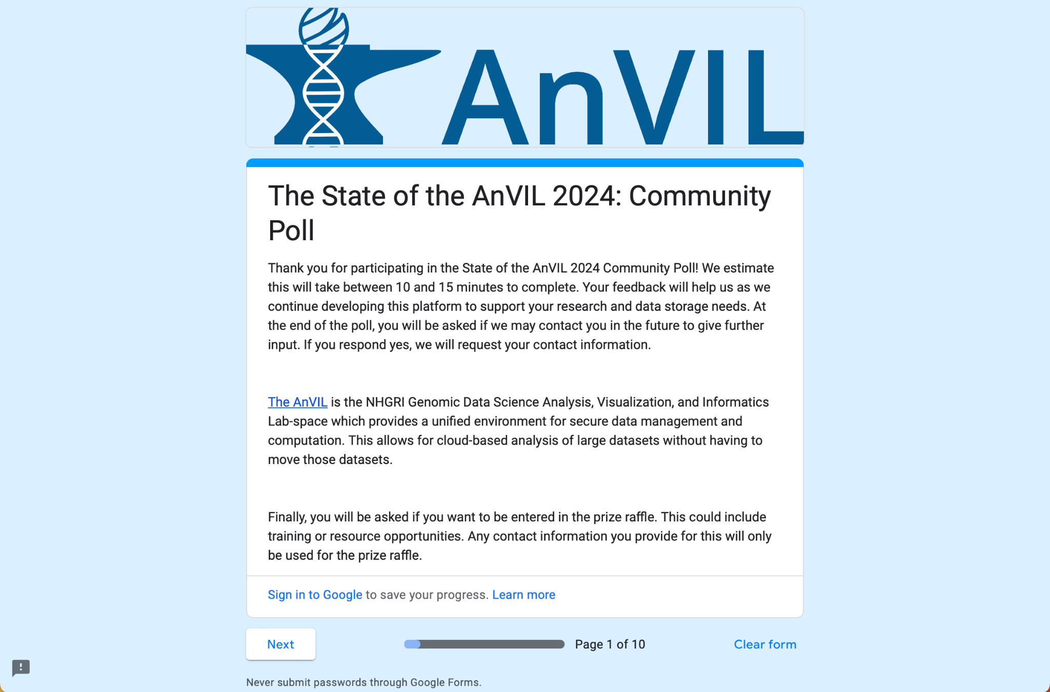
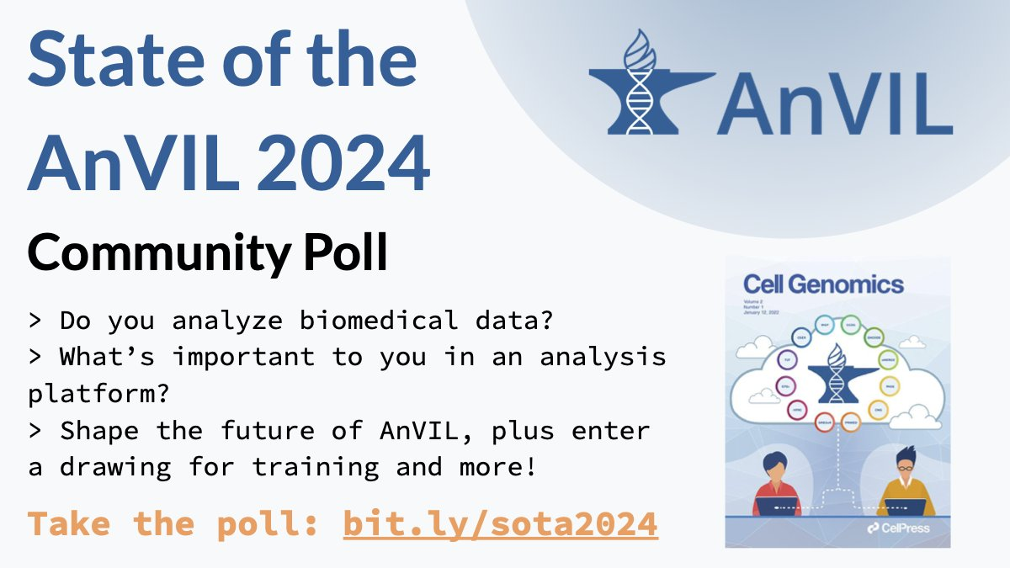
1st Annual Community Poll
twitter.com/useAnVIL/status/1758152939128905973

Slide 3
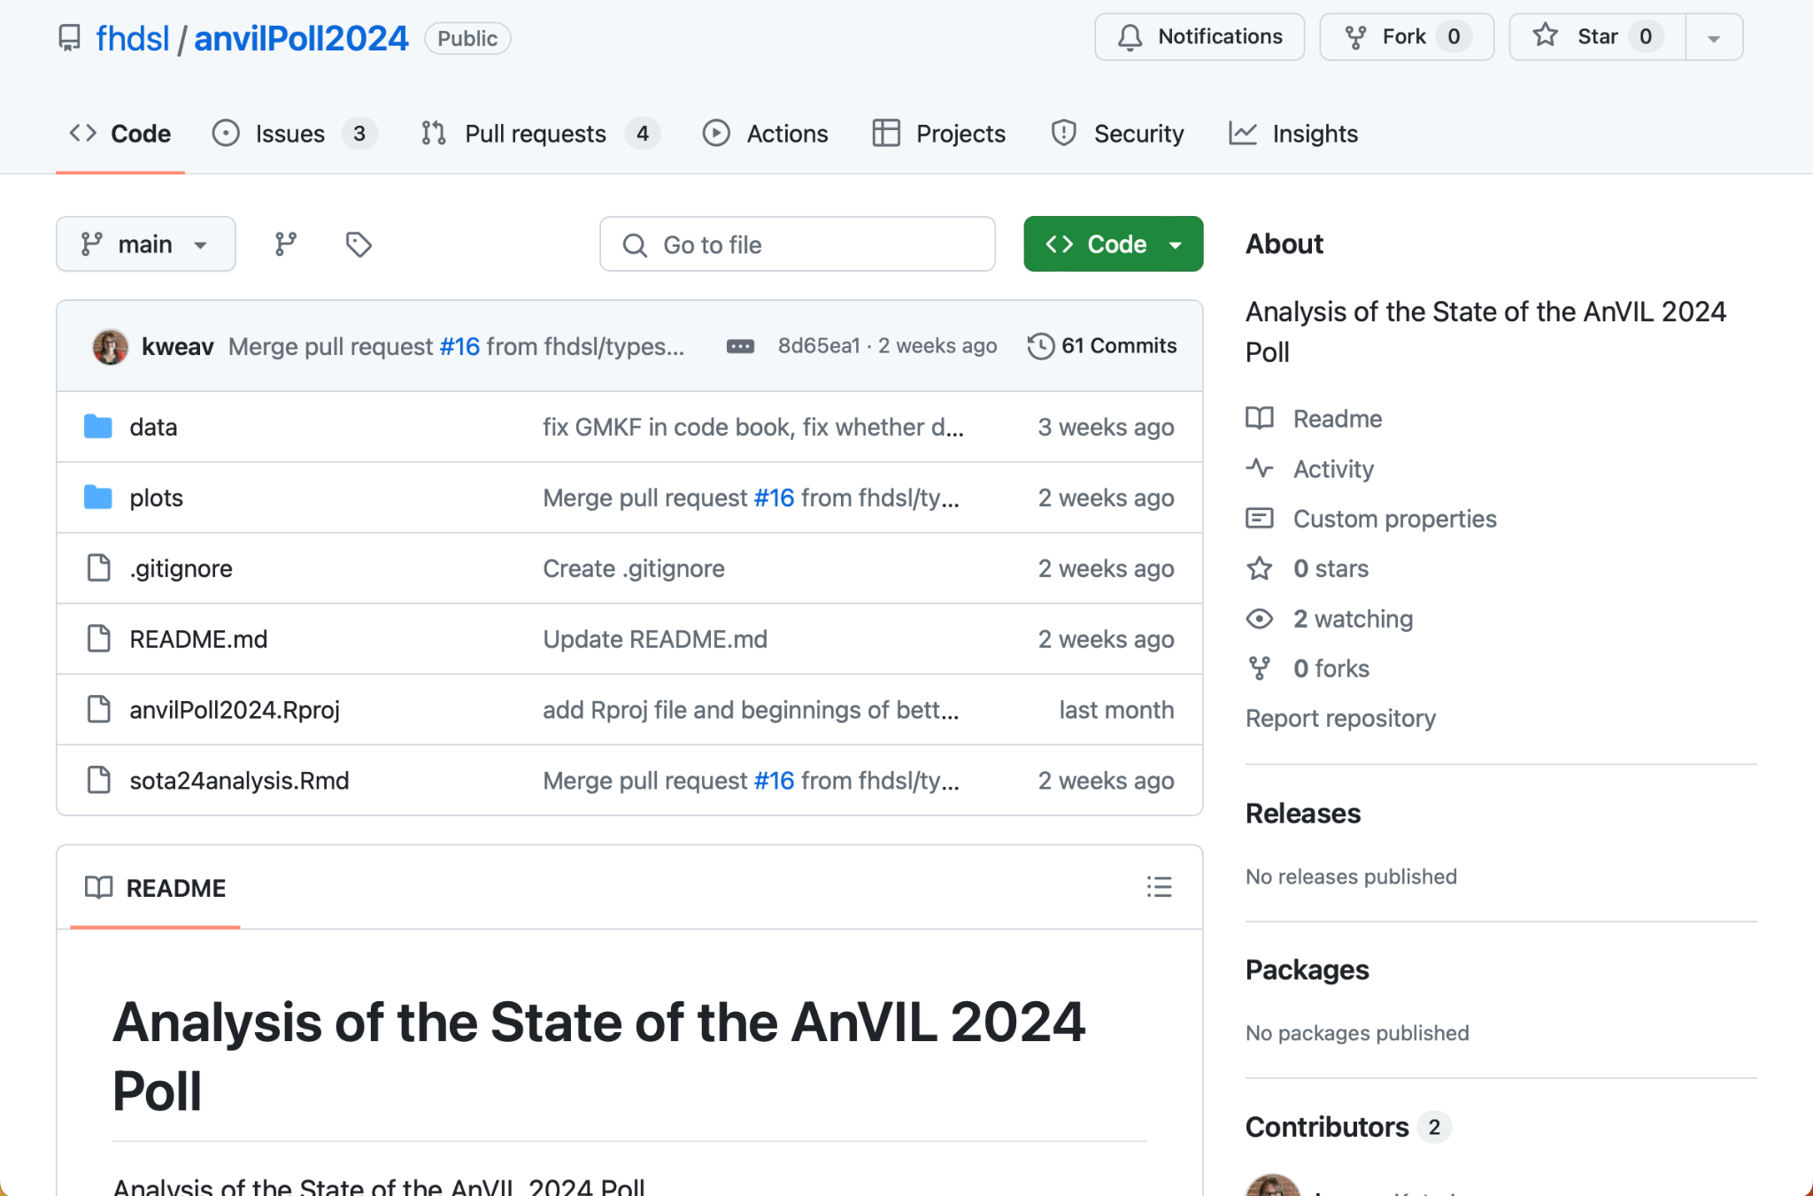
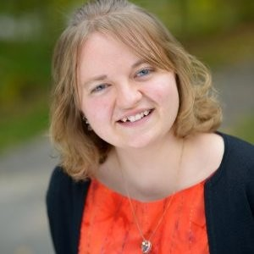
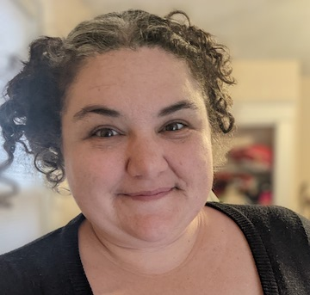
An AnVIL-wide Effort
Kate Isaac
Elizabeth Humphries
Collaborating Across
AnVIL Outreach
Project Managers
Weekly Tech Call
Project Leadership
github.com/fhdsl/anvilPoll2024

Slide 4
Milestones
Fall ‘23 ✅ Begin designing
Dec 18 ✅ Collect wider feedback
Jan 17 ✅ Implement poll
Feb 15 ✅ Conduct poll
Mar 25 🚧 Analyze results
May 1 ✅ Review at AnVIL Outreach
May 17 🚧 Review at AnVIL Leadership
May 29 Present to ECC
Summer ‘24 Follow-up interviews, disseminate (preprint, blog)

Slide 5
hutchdatascience.org/anvilPoll2024/
Report in progress here!

Slide 6
Methods

Slide 7
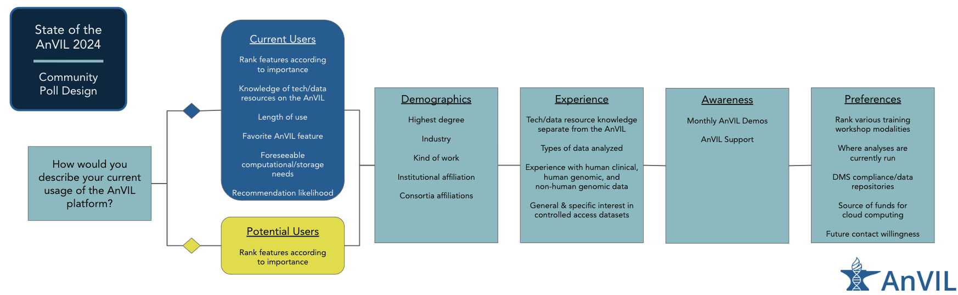
Poll Design

Slide 8
Recruitment
Twitter/LinkedIn
+Retweets
Consortia PM / DCC
NCPI, GREGoR, PRIMED, GDSCN, GRADS-4C
Targeted emails
AnVIL Users, AnVIL Data Submitters, AC2/AC3, AnVIL Demos
Community Slacks
AnVIL, NCPI, Bioconductor, nf-co.re, JHU, Fred Hutch

Slide 9
Demographics
(n=50)

Slide 10
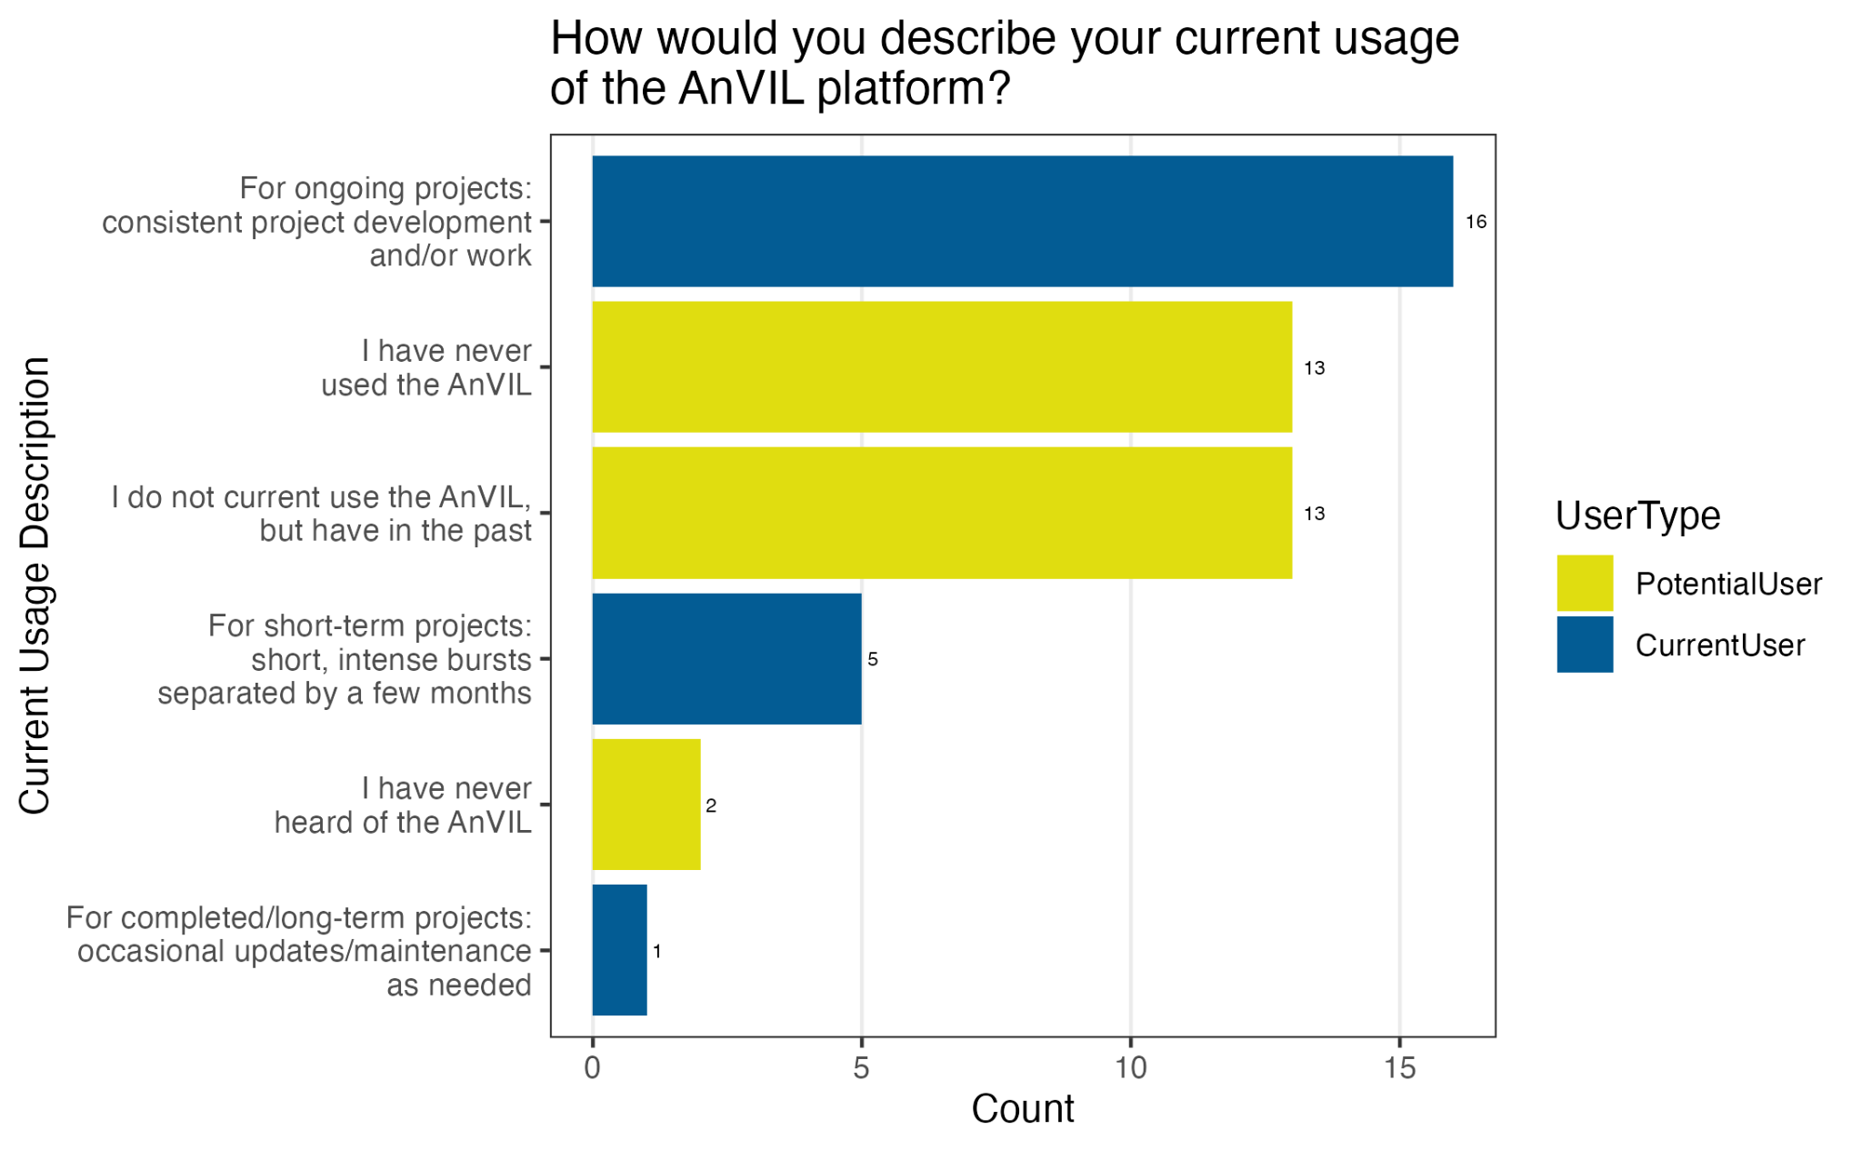
Both current & potential users

Slide 11
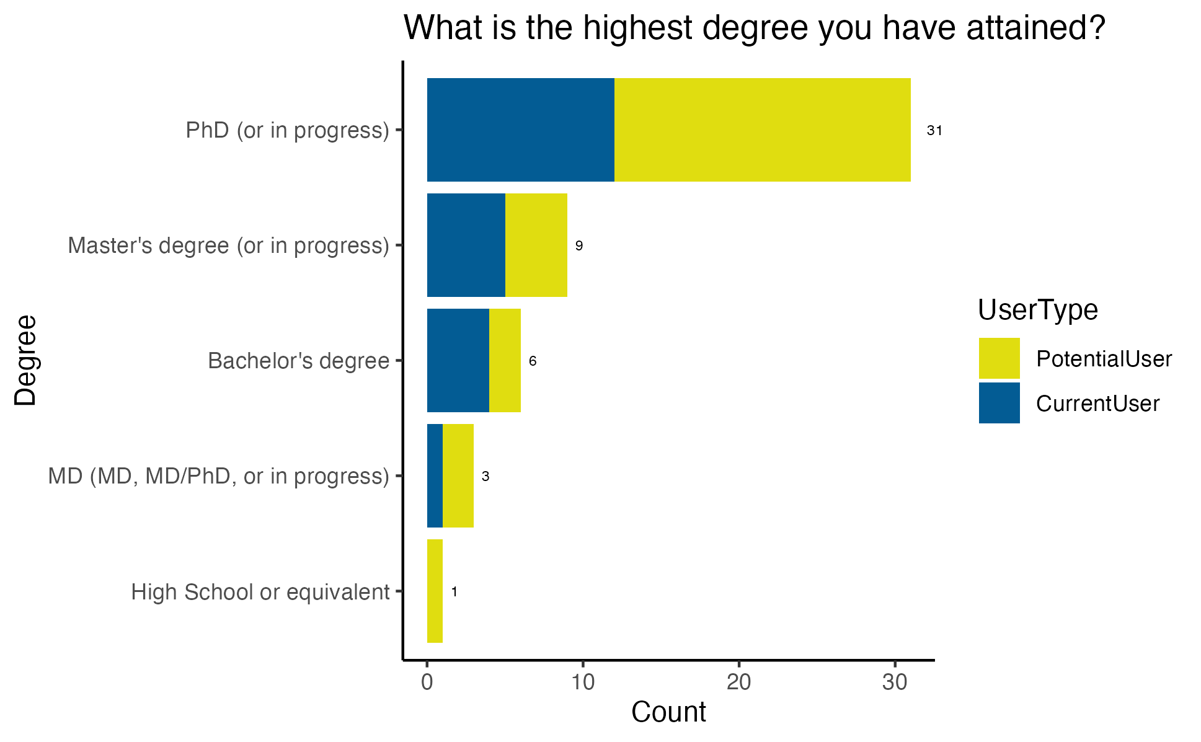
Most responses from PhDs

Slide 12
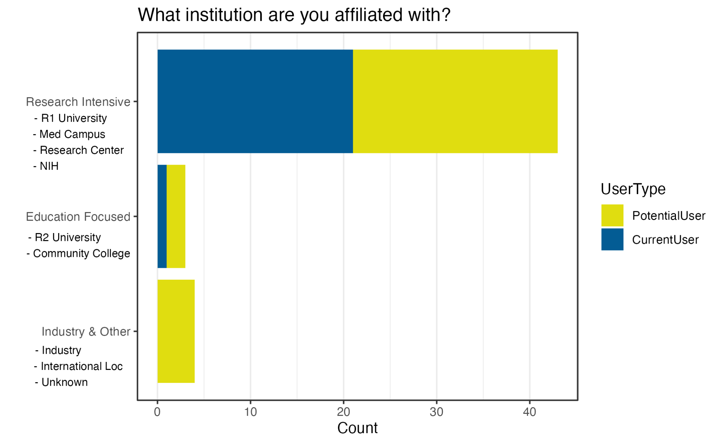
Most responses from R1s
Notes:
Research Intensive
Education Focused
Industry or Other

Slide 13
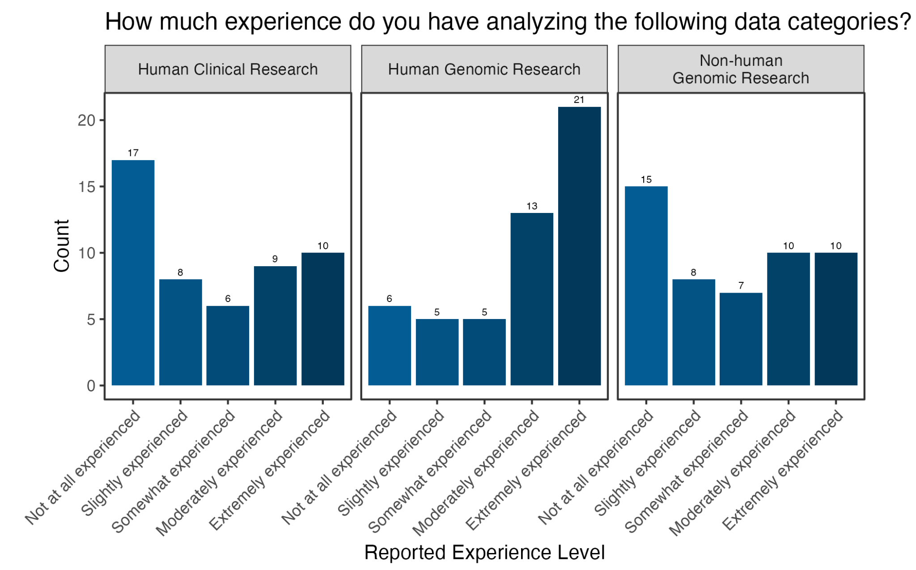
Most familiarity with human genomics

Slide 14
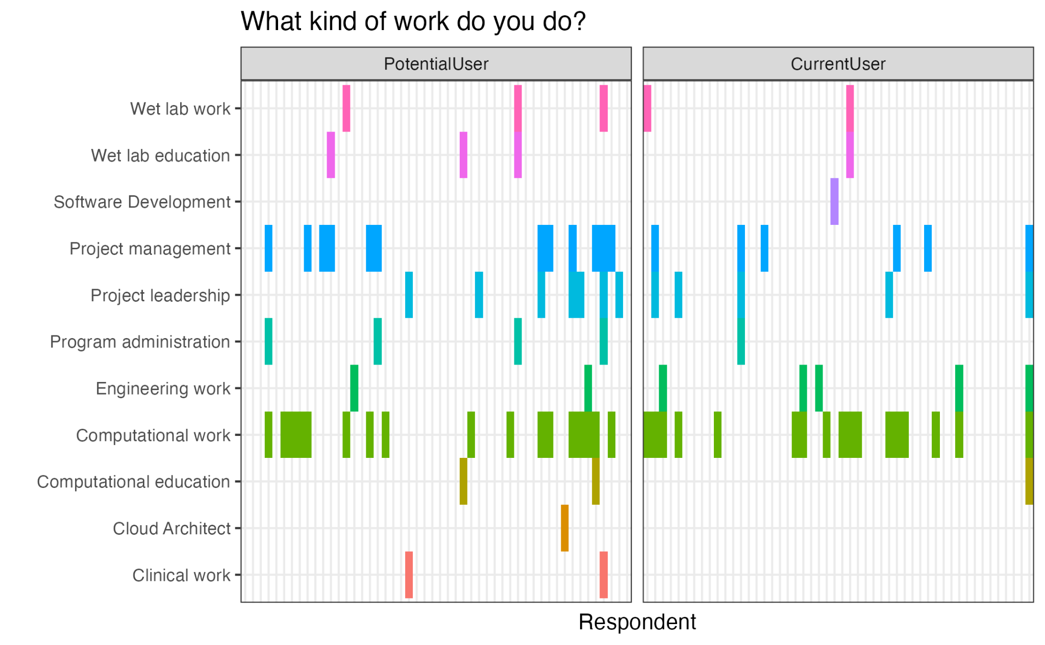
Respondents have varied roles

Slide 15
Additional Demographics
Years working with AnVIL (<1 to 4+ years)
Consortia affiliation (NA, GREGoR, CCDG)

Slide 16
Insights

Slide 17
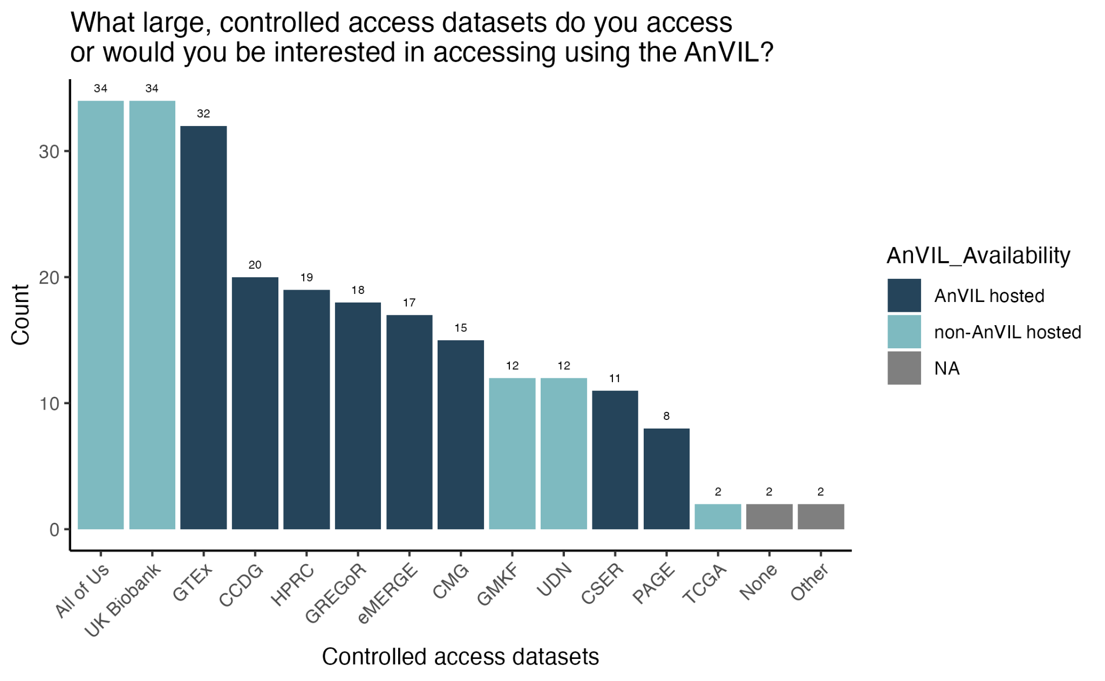
Datasets of Interest
GTEx remains most popular AnVIL dataset
High interest to find a way to interoperate with All of Us and UK Biobank

Slide 18
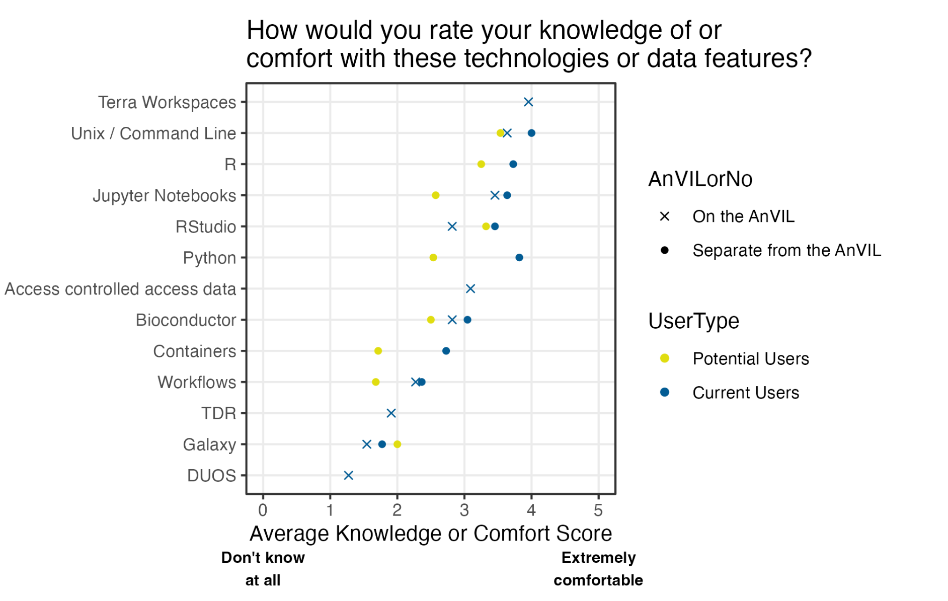
Tools Knowledge/Comfort
Current users have more knowledge potential users
More comfort with Unix/R/Python than Workflows, Containers
Messaging opportunity for TDR, Galaxy, and DUOS

Slide 19
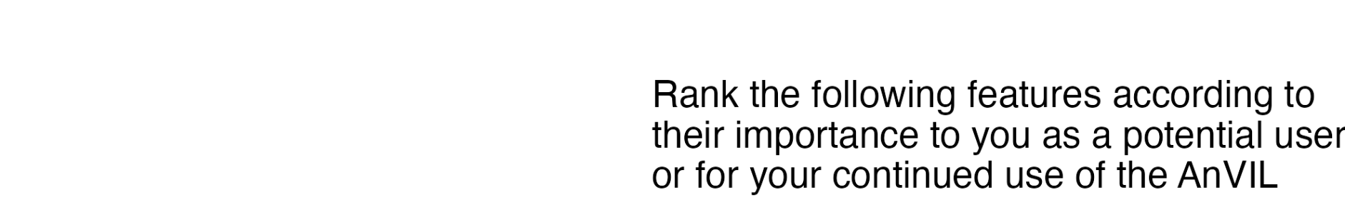
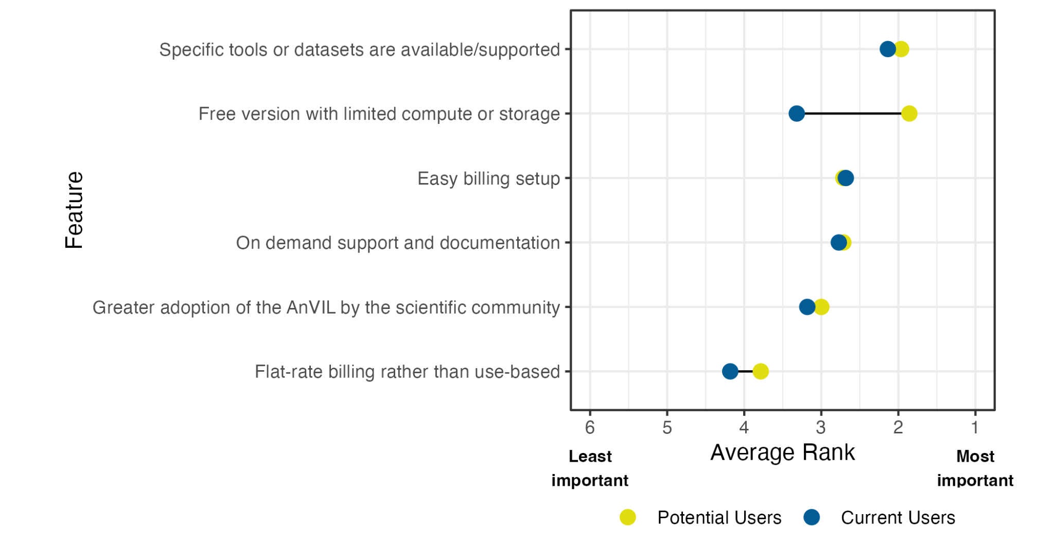
Feature Importance
Specific tools and datasets are most important
Free version biggest draw for potential users

Slide 20
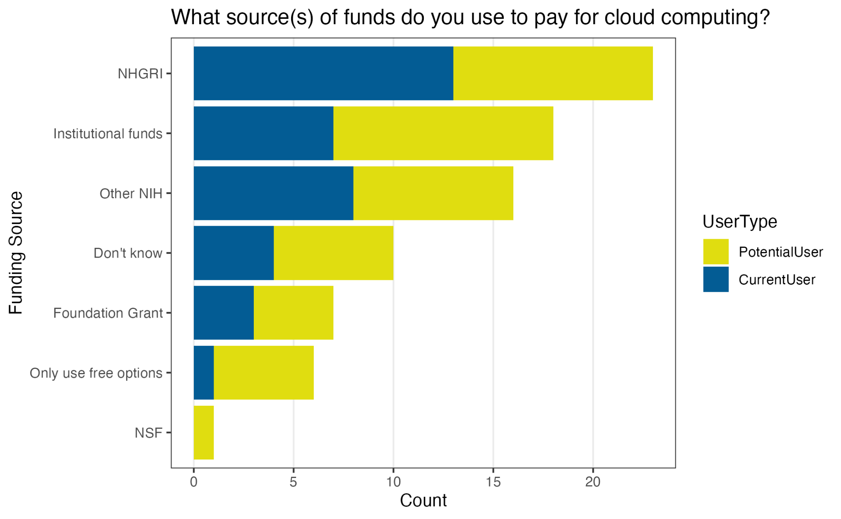
Funding Cloud Computing
Both NHGRI and Other NIH funds are being used
Institutional funds are also being used
Users have multiple sources

Slide 21
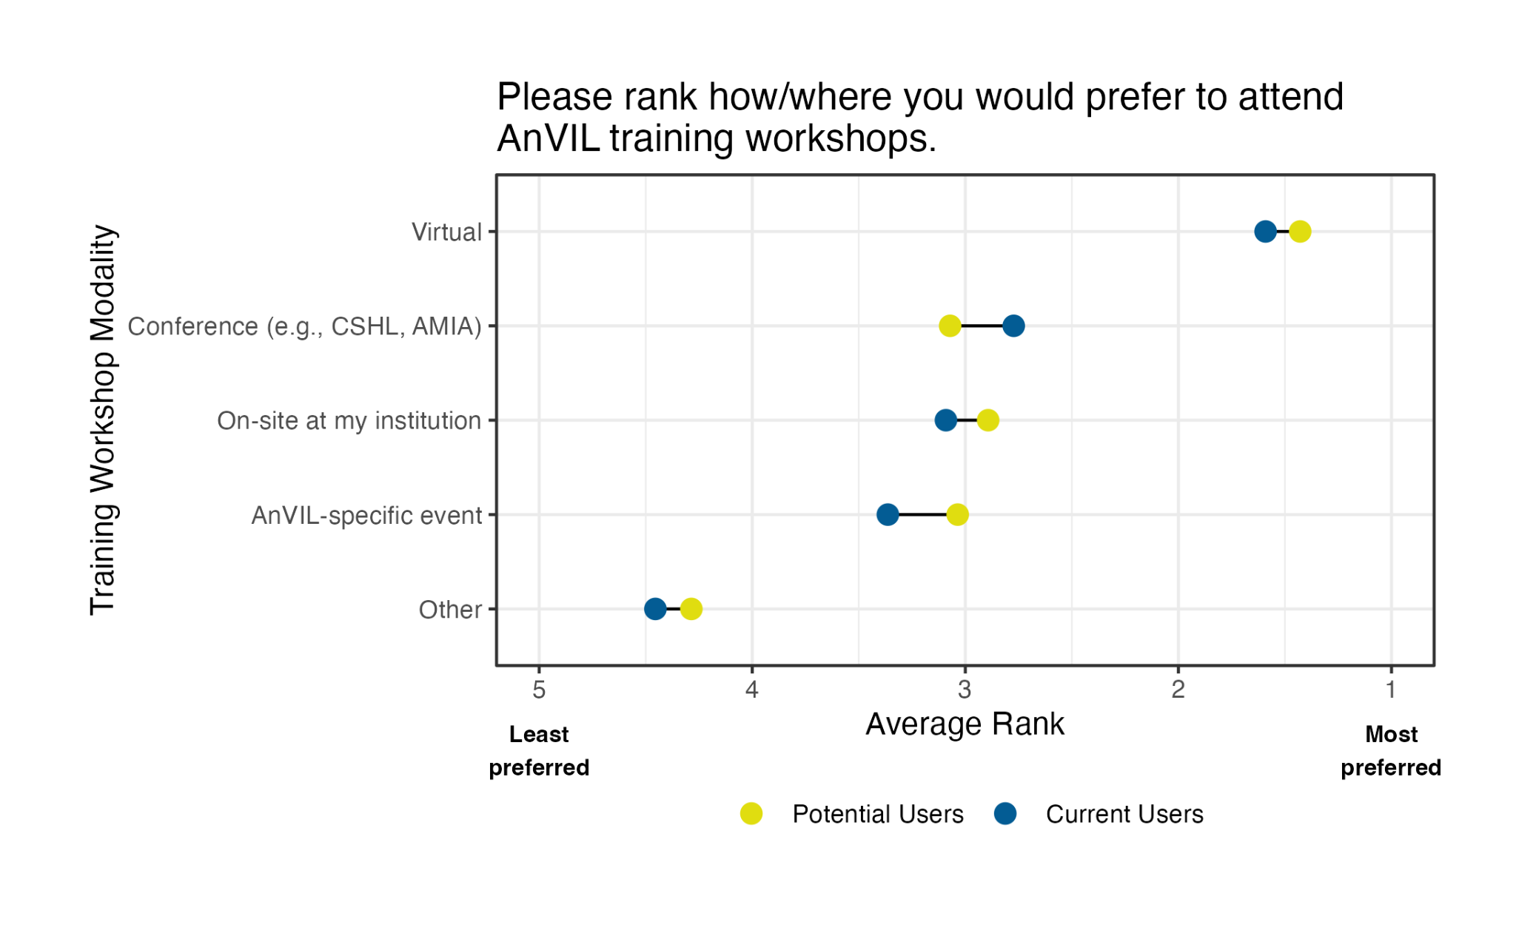
Training Workshop Modality
Strong interest in virtual training events

Slide 22
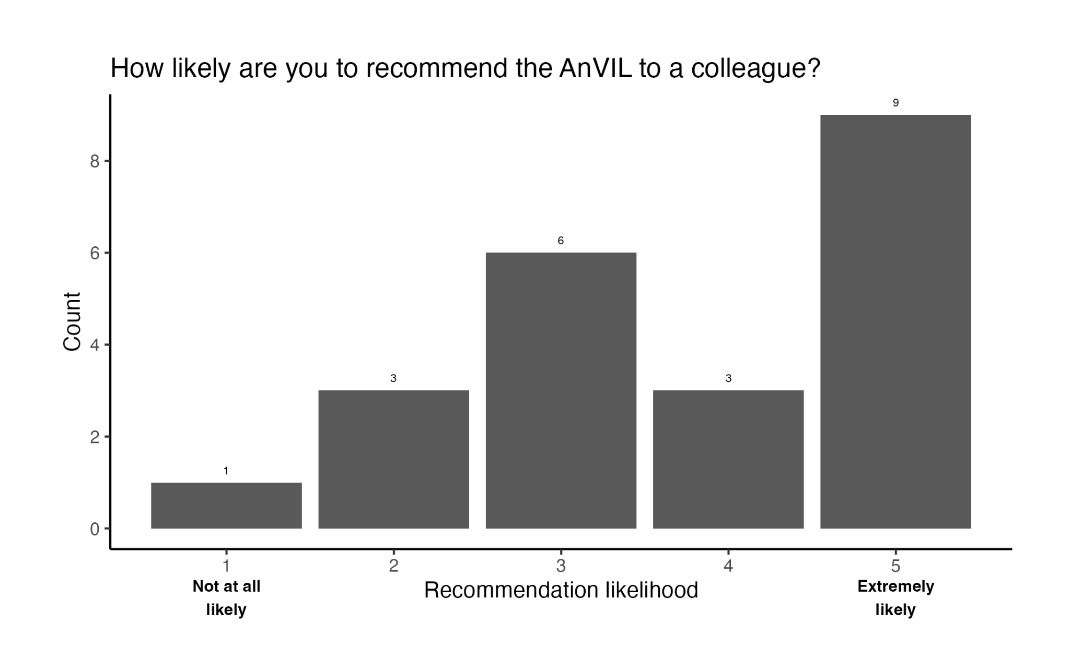
Likelihood to Recommend
Recommendations fall into high and average

Slide 23
Additional Insights
Data types being analyzed
Computing platforms being used
Compute and storage needs in the next 12 months
Awareness of AnVIL training, data repository

Slide 24
Next Steps

Slide 25
Ongoing Work
Follow-up Interviews
32 out of 50 agreed!
Select HPC expert, cloud expert, clinical expert, educator
Report Out
DUOS https://preprints.jmir.org/preprint/49822/accepted
NSF PIs https://pubmed.gov/29049281
Carpentries https://zenodo.org/records/10498453

Slide 26
Lessons Learned for sota2025
Improve list of AnVIL users - “getting the word out”
Has logged in past 12 months
Has not logged in past 24 months
Attended event
Received funding
Allocate budget for incentives
Apparel, water bottles, technology
Work with local experts
Queenie Ho, Jennifer Hall

Slide 27
Extra Slides

Slide 28
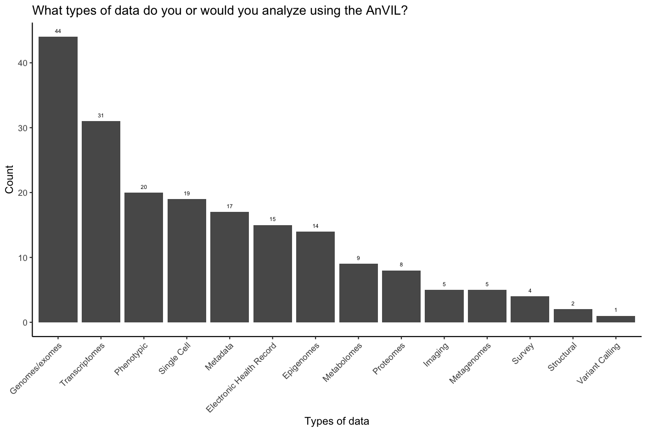
Dataset interests

